Slide 1
Introduction to Machine Learning (Hands-on for Classification and Clustering )
Naresh and Upendra
Note: Slides gathered from internet and adapted to this talk.

Slide 2
Types of Machine Learning
Supervised Learning
Data + labels
E.g. Classification, Regression
Un-Supervised Learning
Data
E.g. Clustering , Dimensionality Reduction

Slide 3
Supervised Learning
A dataset is provided with n data points and corresponding labels
{(X₁, y₁) (X₂, y₂), ……, (X_{n}, y_{n})}
The goal here is to find a function , f which gives an output for a new example: f(y|X)

Slide 4
Supervised Learning Pipeline
Training
Supervised ML Algorithm
Training Data
Feature Engineering
Evaluate Classifier on Validation Data
Labels
Is accuracy achieved or Best Model
Change the config of feature generation and model parameters
No
Yes
Prediction
Final Classification Model
Feature Engineering
Class label and Score
Test Example

Slide 5
Supervised learning algorithms
k-Nearest Neighbors
Logistic Regression
Support Vector Machine
Feed Forward Neural Network
Random Forest Classifier
Gradient Boosting, etc.
Deep learning-based methods

Slide 6
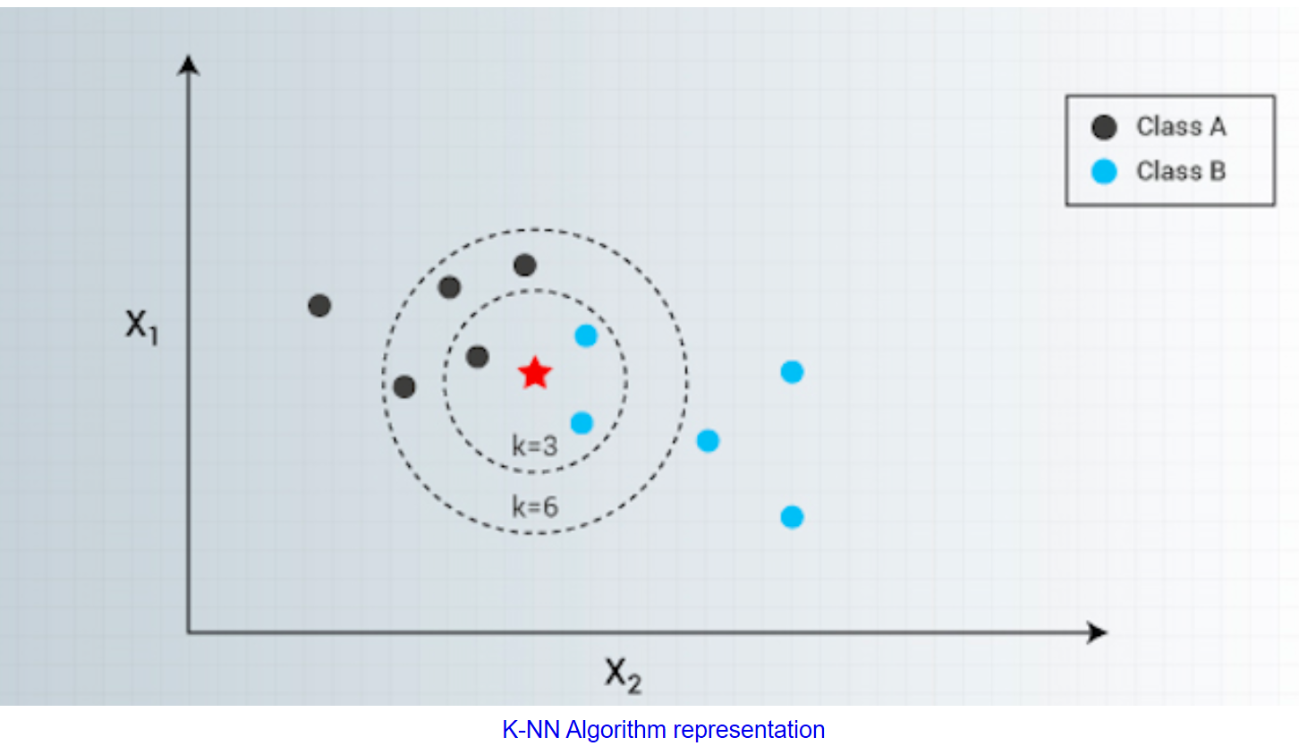
k-NN
K-Nearest Neighbors is one of the most famous classification algorithms
It’s simple and accurate.
It’s there in statistics world for quite some years under non-parametric techniques.
Assumption: Similar things exists in proximity!

Slide 7
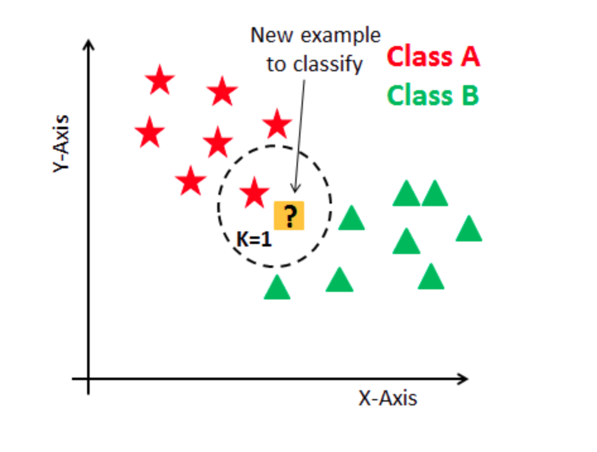
How k-NN works
Given: {Data, class labels}
What’s the label for new data point?
Steps:
Calculate distance
Find closest neighbors
Vote for labels (Max Rule)

Slide 8
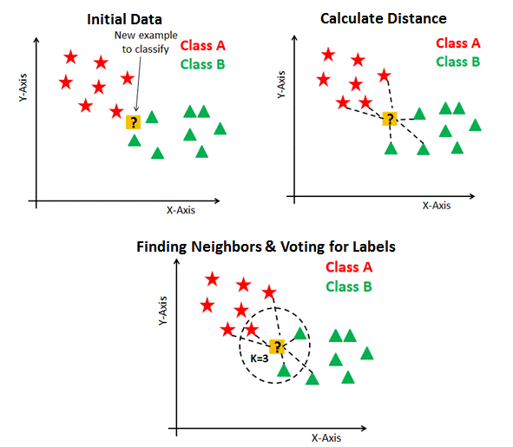
How k-NN works

Slide 9
Tuning k value
k is a controlling variable for the prediction model.
A large k value is more precise as it reduces the overall noise !
Range: 1 and ~10% of training data set size!
Cross-validation : Use an independent dataset to validate the k value.
Generally, an odd number is chosen if the number of classes is even.

Slide 10

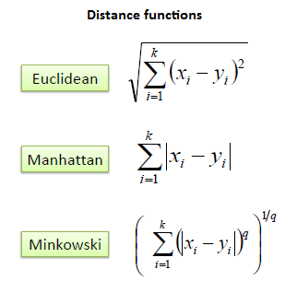
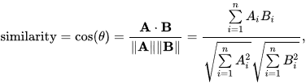
Distance Function

Slide 11
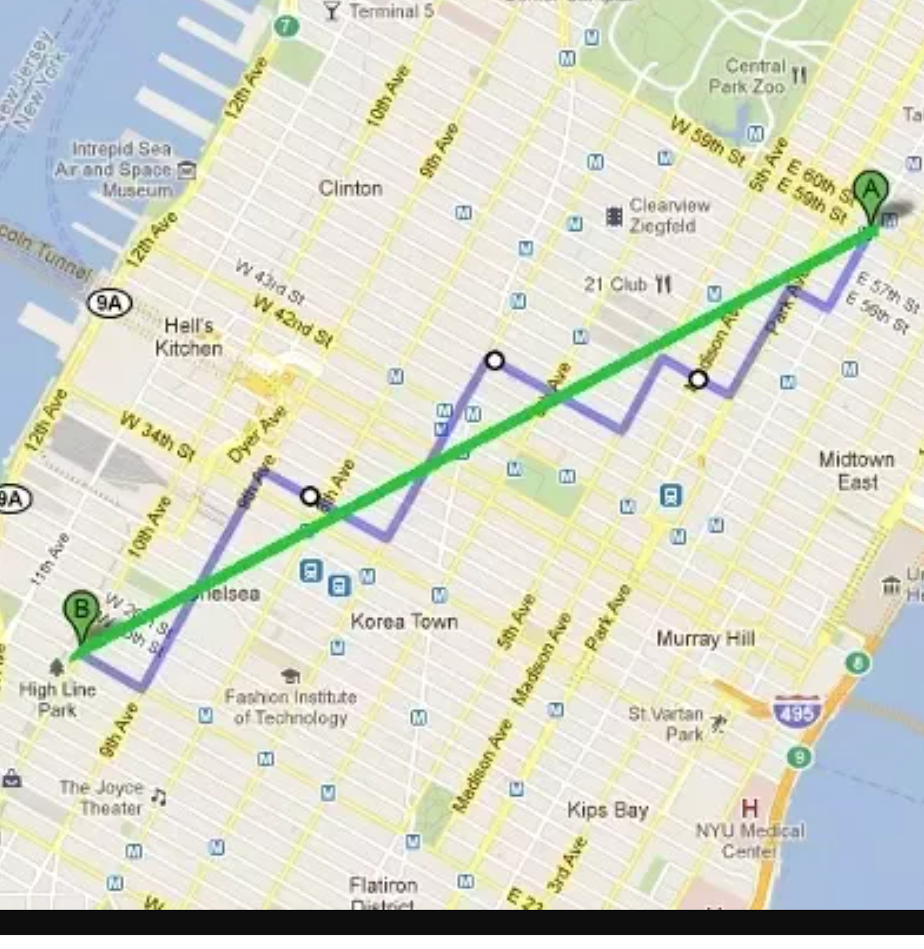
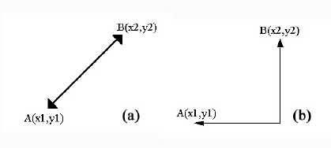
Manhattan vs Euclidean

Slide 12

Evaluation Metric
C11 | C12 | C13
C21 | C22 | C23
C31 | C32 | C33
True label
Predicted label

Slide 13
Memory & Runtime
Storing the complete training data. So, the memory needs grow linearly with the number of data points you provide for training.
All calculations happen during model inference. Hence, the scoring runtime scales linearly with the number of data columns and the number of training points.
Very suitable for off-line tasks.

Slide 14
k-NN
Advantages:
k-NN is a simple but effective classification procedure
Applies to multi-class classification
Decision surfaces are non-linear
Quality of predictions automatically improves with more training data
Only a single parameter, K. easily tuned by cross-validation
Disadvantages:
May not scale well with the increase in data dimension (curse of dimensionality!)
Memory (we need to keep all the training examples)

Slide 15
Hands-on
Iris dataset
Digit classification

Slide 16
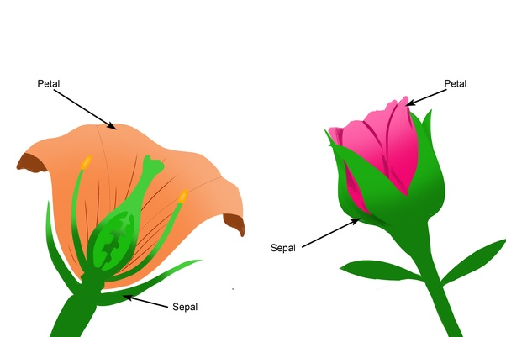
Iris Dataset
150 examples
4 features
Sepal width
Sepal length
Petal width
Petal length

Slide 17

Digits dataset
Total: 1796
10 classes
Each image 8*8 size

Slide 18
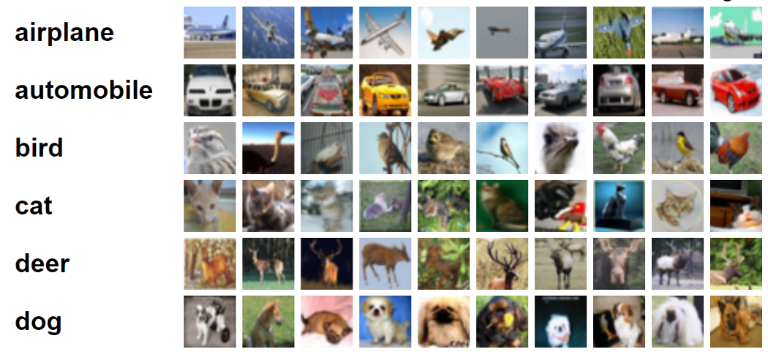
CIFAR10

Slide 19
Unsupervised Learning

Slide 20
Clustering
Requires data, but no labels
Detect patterns
Group emails or search results
Customer shopping patterns
Regions of images
Useful when don’t know what you’re looking for
Basic idea: group together similar instances

Slide 21
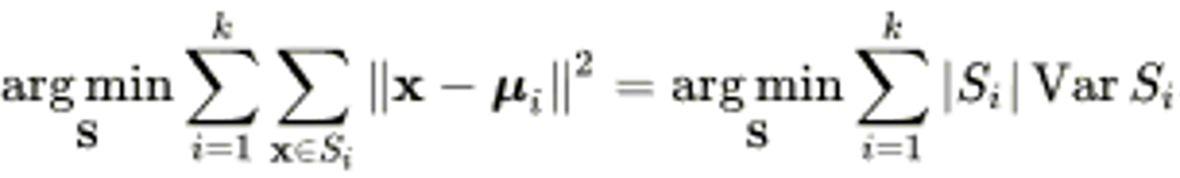
K-Means
Given a set of examples (x₁, x₂, …, x_{n}), where each examples is a d-dimensional real vector
K-means clustering aims to partition the n observations into k (≤ n) sets S = {S₁, S₂, …, S_{k}} so as to minimize the within-cluster sum of squares (WCSS)
Minimize the WCSS (inter) and maximize (intra) BCSS (between-cluster sum of squares)

Slide 22
K-Means
An iterative clustering algorithm
Initialize: Pick K random points as cluster centers
Alternate:
Assign data points to closest cluster center
Change the cluster center to the average of its assigned points
Stop when no pointsʼ assignments change

Slide 23
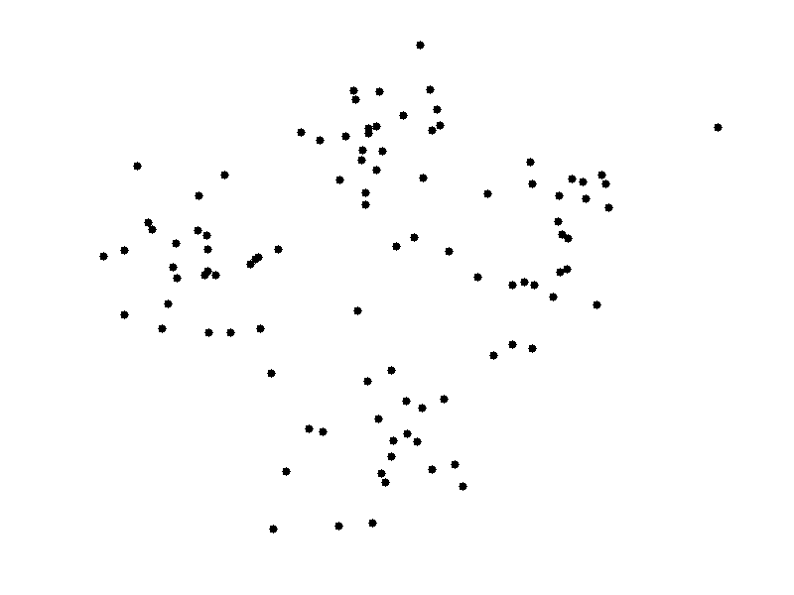
K-Means (4)

Slide 24
Evaluation Methods
Clustering analysis doesn’t have a solid evaluation metric, as there is no ground truth data.
Most popular evaluation methods:
Elbow method
Silhouette analysis

Slide 25
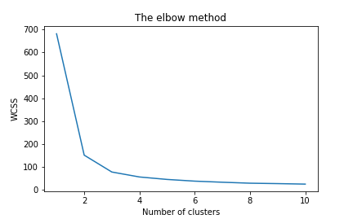
Elbow method
Helps us to find what a good k be based on the sum of squared distance (SSE) between data points and their assigned clusters’ centroids.

Slide 26

Silhouette analysis

Slide 27
K-Means
Advantages
Easy to use
Need to know K
May need to scale data
Good initial method
Local optima
No guarantee of optimal solution
Repeat with different starting values

Slide 28
Hands-on
Iris dataset
Digit dataset

